Slide 1
Software Quality Engineering
Lecture 2
Part II-software testing
Functional testing
alina.arshad@nu.edu.pk

Slide 2
Pair-wise testing
Pairwise Testing is a test design technique that delivers hundred percent test coverage.
A black-box test design technique in which test cases are designed to execute all possible discrete combinations of each pair of input parameters.
Techniques like boundary value analysis and equivalence partitioning can be useful to identify the possible values for individual factors. But it is impractical to test all possible combinations of values for all those factors. So instead a subset of combinations is generated to satisfy all factors.
All-Pairs technique is very helpful for designing tests for applications involving multiple parameters. Tests are designed such that for each pair of input parameters to a system, there are all possible discrete combinations of those parameters. The test suite covers all combinations; therefore it is not exhaustive yet very effective in finding bugs

Slide 3
Example
An application with simple list box with 10 elements (Let's say 0,1,2,3,4,5,6,7,8,9) along with a checkbox, radio button, Text Box and OK Button. The Constraint for the Text box is it can accept values only between 1 and 100. Below are the values that each one of the GUI objects can take :
List Box - 0,1,2,3,4,5,6,7,8,9
Check Box - Checked or Unchecked
Radio Button - ON or OFF
Text Box - Any Value between 1 and 100
Exhaustive combination of the product B is calculated
List Box = 10
Check Box = 2
Radio Button = 2
Text Box = 100
Total Number of Test Cases using Cartesian Method : 10*2*2*100 = 4000
Total Number of Test Cases including Negative Cases will be > 4000

Slide 4
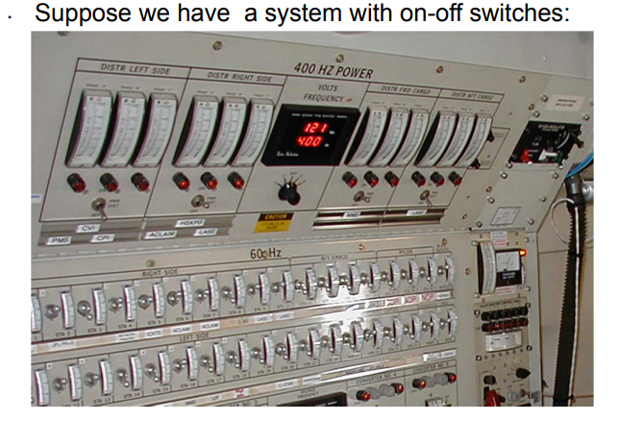
Some examples

Slide 5
Example: Suppose there is a software to be tested which has 20 inputs and 20 possible settings for each input so in that case there are total 20^20 possible inputs to be tested. Therefore in this case, exhaustive testing is impossible even all combinations are tried to be tested.
Notes:
https://www.geeksforgeeks.org/pairwise-software-testing/

Slide 6
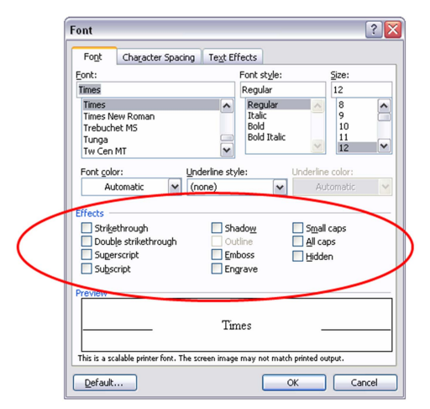
Some examples

Slide 7
Some more examples
Car Ordering Application:
The car ordering application allows for Buying and Selling cars. It should support trading in Delhi and Mumbai.
The application should have registration numbers, may be valid or invalid. It should allow the trade of following cars: BMW, Audi, and Mercedes.
Two types of booking can be done: E-booking and In Store.
Orders can be placed only during trading hours.
Notes:
https://www.softwaretestinghelp.com/what-is-pairwise-testing/

Slide 8
Step #1: Let’s list down the variables involved.
1) Order category a. Buy b. Sell
2) Location a. Delhi b. Mumbai
3) Car brand a. BMW b. Audi c. Mercedes
4) Registration numbers a. Valid (5000) b. Invalid
5) Order type a. E-Booking b. In-store
6) Order time a. Working hours b. Non-working hours
If we want to test all possible valid combinations: = 2 X 2 X 3 X 5000 X 2 X 2 = 240000 Valid test cases combinations :(
There is also an infinite number of invalid combinations.

Slide 9
Step #2: Let’s simplify
– Use a smart representative sample. – Use groups and boundaries, even when data is non-discrete. – Reduce Registration Number to Two
Valid registration number
Invalid registration number
Now let’s calculate the number of possible combinations = 2 X 2 X 3 X 2 X 2 X 2 = 96

Slide 10

Step #3: Arranging variables and values involved.
When we arrange variables and values involved, it looks something like this.
Now order the variables so that the one with the most number of values is first and the least is last.

Slide 11
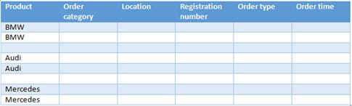
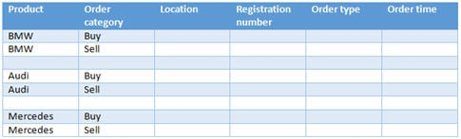
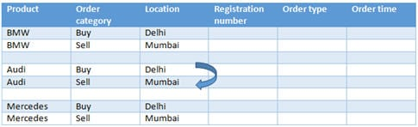
Step #4: Arrange variables to create a test suite
Start filling in the table column by column. Initially, the table should look something like this. The three values of Product (variable having the highest number of values) should be written two times each (two is the number of values of next highest variable i.e. Order category).
For each set of values in column 1, we put both values of column 2. Repeat the same for column 3.

Slide 12
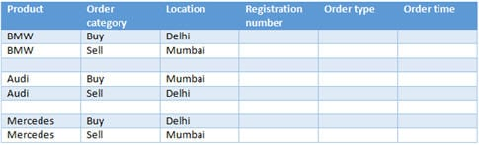
We have a Buy and Delhi, but wait – there’s no Buy and Mumbai. We have a Sell and Mumbai, but there’s no Sell and Delhi. Let’s swap around the values in the second set in the third column.

Slide 13
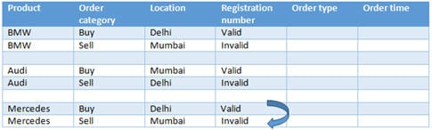
We will repeat the same steps for column 3 and 4.
When columns 3 and 4 are compared, each value in column 3 has both the values of column 4. But when you compare the 2nd and 4th column, we have Buy and Valid & Sell and Invalid .i.e. Buy does not have an “Invalid” and Sell does not have a “Valid”. Hence we need to interchange the last set of values in the 4th column.

Slide 14
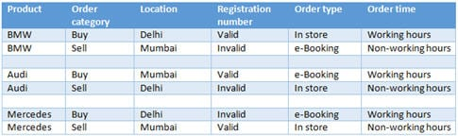

Slide 15
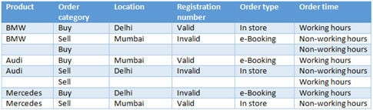
Hurray! All pairs in 8 cases, instead of all combinations in 96!
Column 6 (Order time) is problematic. We are missing Buy/Non-working hours and Sell/Working hours. We can’t fit our missing pairs by swapping around values as we already swapped all the rows if we swap now we may miss other possible pairs which are already sorted. So, we add two more test cases that contain these pairs. Hence, the blank rows!

Slide 16
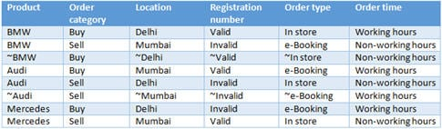
Hurray! All pairs in 8 cases, instead of all combinations in 96!

Slide 17
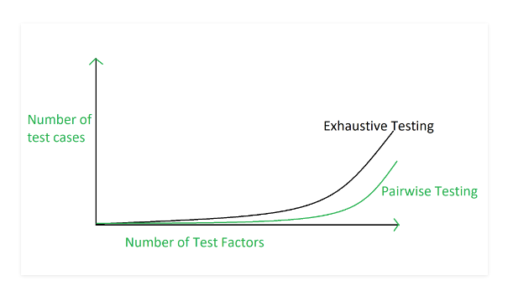
Graphical Representation of Pairwise Testing

Slide 18
Hotel Room Booking System:
The system allows customers to book rooms in a hotel. It supports bookings for single or double rooms in three cities: New York, Los Angeles, and Chicago. The system also allows guests to select whether they want a breakfast option, and reservations can be made either during peak season or off-peak season. Finally, bookings can be made online or in person at the hotel.

Slide 19
Advantages & Disadvantages of Pairwise Testing
Pairwise testing reduces the number of execution of test cases.
Pairwise testing increases the test coverage almost up to hundred percentage.
Pairwise testing increases the defect detection ratio.
Pairwise testing takes less time to complete the execution of the test suite.
Pairwise testing reduces the overall testing budget for a project.
Disadvantages:
Pairwise testing is not beneficial if the values of the variables are inappropriate.
In pairwise testing it is possible to miss the highly probable combination while selecting the test data.
In pairwise testing, defect yield ratio may be reduced if a combination is missed.
Pairwise testing is not useful if combinations of variables are not understood correctly.

Slide 20
Any question????

